Slide 1
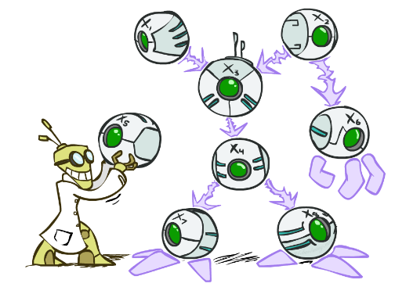
CS 188: Artificial Intelligence
Bayes’ Nets
Instructors: Sergey Levine --- University of California, Berkeley
[These slides were created by Dan Klein and Pieter Abbeel for CS188 Intro to AI at UC Berkeley. All CS188 materials are available at http://ai.berkeley.edu.]
Notes:
Please retain proper attribution, including the reference to ai.berkeley.edu. Thanks!

Slide 2

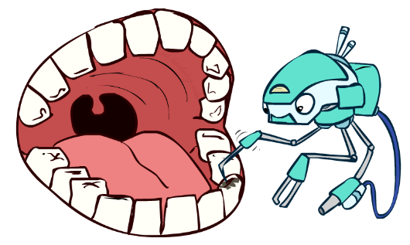
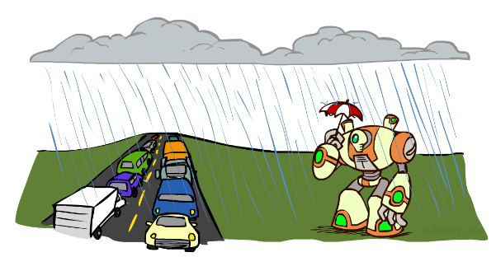
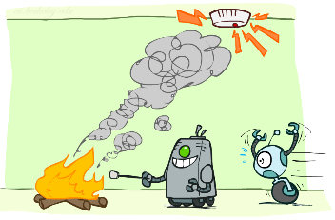
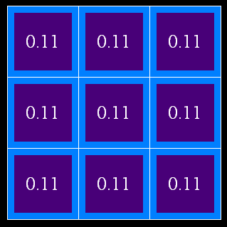
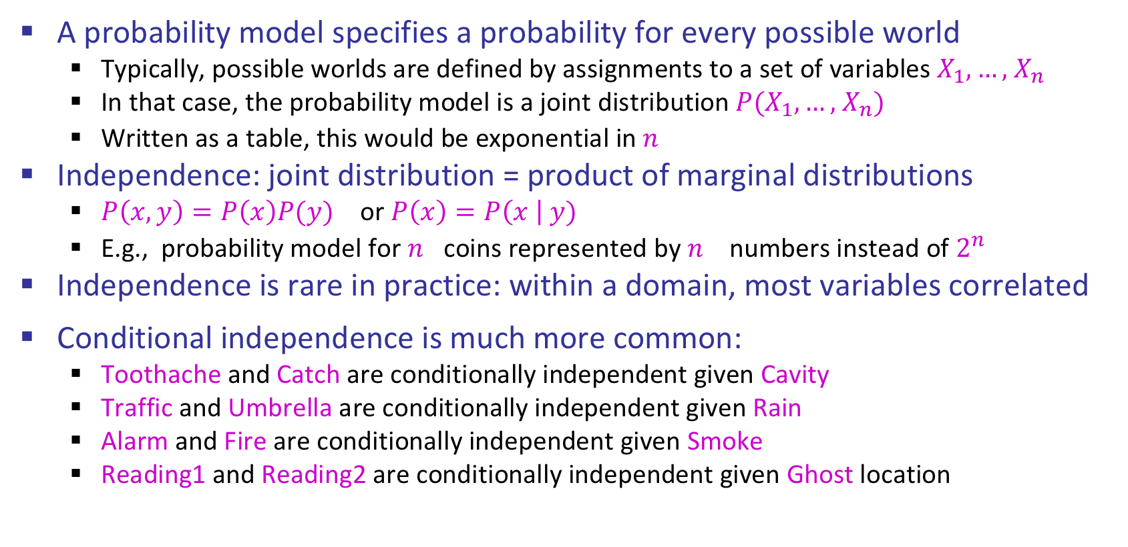
Reminders
A probability model specifies a probability for every possible world
Typically, possible worlds are defined by assignments to a set of variables $X_{1},…,$ $X_{n}$
In that case, the probability model is a joint distribution ${P(X}_{1},…,$ $X_{n})$
Written as a table, this would be exponential in $n^{}$
Independence: joint distribution = product of marginal distributions
${P\left(x,y\right)=P\left(x\right)P(y)}_{}$ or $P\left(x\right)=P\left(x \right| y)$
E.g., probability model for $n^{}$coins represented by $n^{}$ numbers instead of $2^{n}$
Independence is rare in practice: within a domain, most variables correlated
Conditional independence is much more common:
Toothache and Catch are conditionally independent given Cavity
Traffic and Umbrella are conditionally independent given Rain
Alarm and Fire are conditionally independent given Smoke
Reading1 and Reading2 are conditionally independent given Ghost location
?
?
?
?
?
?
?
?
?

Slide 3
Ghostbusters, Revisited
What about two readings? What is P(r₁,r₂ | g) ?
Readings are conditionally independent given the ghost location!
P(r₁,r₂ | g) = P(r₁ | g) P(r₂ | g)
Applying Bayes’ rule in full:
P(g | r₁,r₂ ) α P(r₁,r₂ | g) P(g)
= P(g) P(r₁ | g) P(r₂ | g)
Bayesian updating using low-dimensional conditional distributions!!
?
?
?
?
?
?
?
?
?
0.24
0.07
<.01
0.07
0.24
0.07
<.01
0.07
0.24

Slide 4
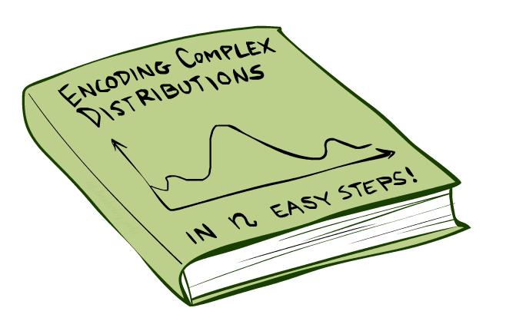
Bayes Nets: Big Picture

Slide 5


Bayes Nets: Big Picture
Bayes nets: a technique for describing complex joint distributions (models) using simple, local distributions (conditional probabilities)
A subset of the general class of graphical models
Take advantage of local causality:
the world is composed of many variables,
each interacting locally with a few others
For about 10 min, we’ll be vague about how these interactions are specified

Slide 6
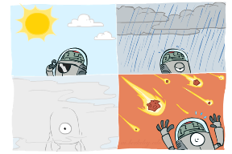
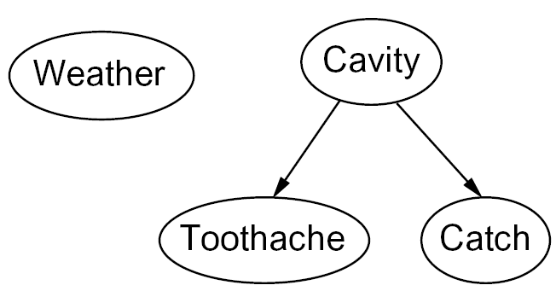

Graphical Model Notation
Nodes: variables (with domains)
Can be assigned (observed) or unassigned (unobserved)
Arcs: interactions
Similar to CSP constraints
Indicate “direct influence” between variables
Formally: encode conditional independence (more later)
For now: imagine that arrows mean direct causation (in general, they don’t!)

Slide 7

Example: Coin Flips
N independent coin flips
No interactions between variables: absolute independence
X₁
X₂
X_{n}

Slide 8
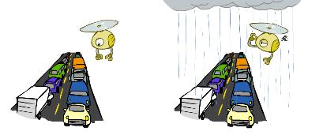
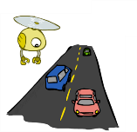
Example: Traffic
Variables:
T: There is traffic
U: I’m holding my umbrella
R: It rains
R
T
U

Slide 9
Example: Smoke alarm
Variables:
F: There is fire
S: There is smoke
A: Alarm sounds
F
S
A

Slide 10
Example: Ghostbusters
Ghost
0.24
0.07
<.01
0.07
0.24
0.07
<.01
0.07
0.24
R1
R2
R3

Slide 11
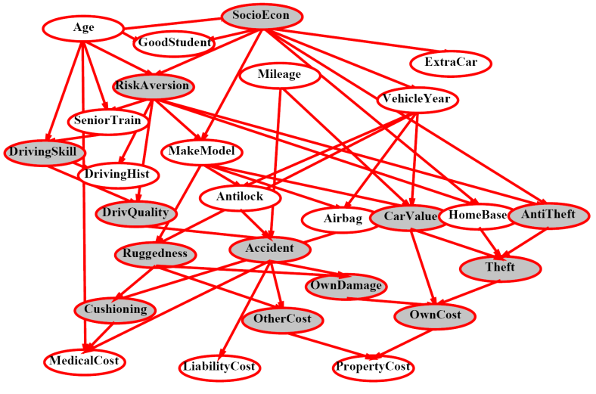
Example Bayes’ Net: Insurance

Slide 12
Example Bayes’ Net: Car

Slide 13
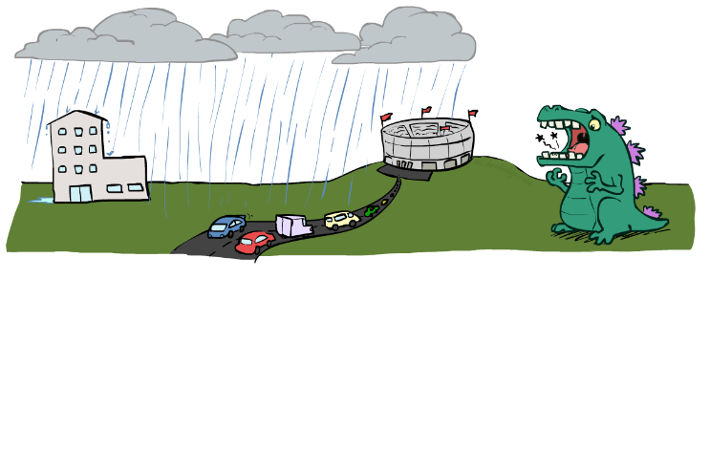
Can we build it?
Variables
T: Traffic
R: It rains
L: Low pressure
D: Roof drips
B: Ballgame
C: Cavity

Slide 14
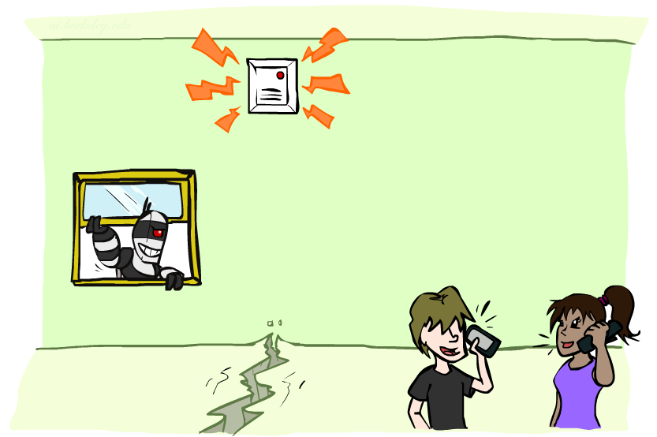
Can we build it?
Variables
B: Burglary
A: Alarm goes off
M: Mary calls
J: John calls
E: Earthquake!

Slide 15
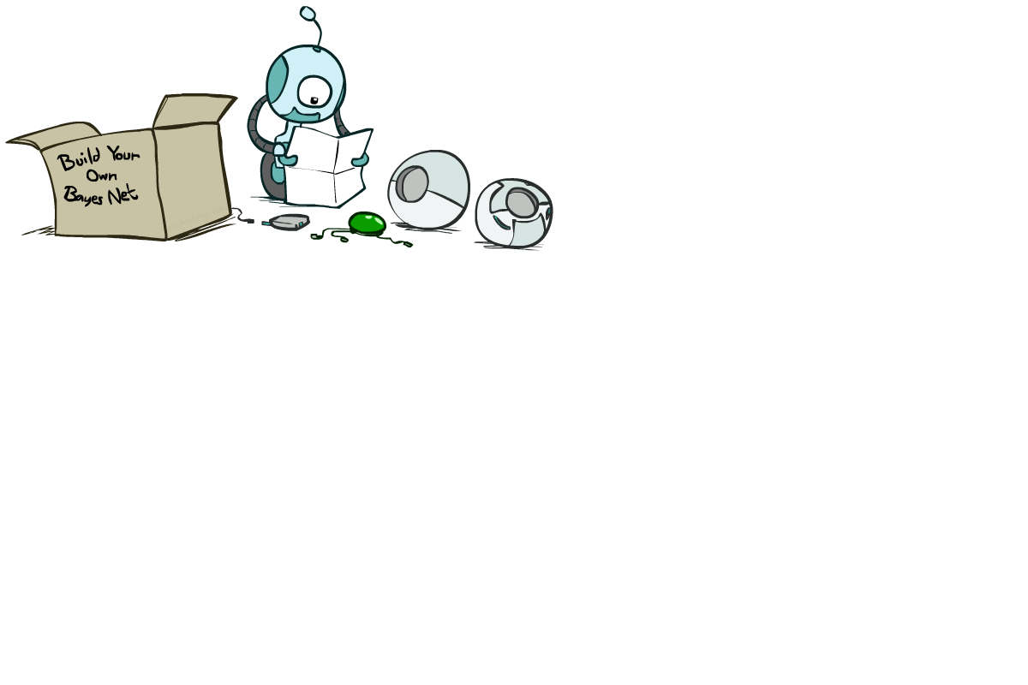
Bayes Net Syntax and Semantics

Slide 16
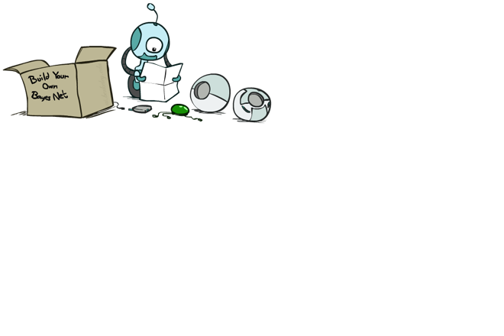
Bayes Net Syntax
A set of nodes, one per variable X_{i}
A directed, acyclic graph
A conditional distribution for each node given its parent variables in the graph
CPT: conditional probability table: each row is a distribution for child given a configuration of its parents
Description of a noisy “causal” process
Ghost | P(Color_{1,1} | Ghost)
 | g | y | o | r
(1,1) | 0.01 | 0.1 | 0.3 | 0.59
(1,2) | 0.1 | 0.3 | 0.5 | 0.1
(1,3) | 0.3 | 0.5 | 0.19 | 0.01
…
P(Ghost)
(1,1) | (1,2) | (1,3) | …
0.11 | 0.11 | 0.11 | …
Ghost
Color_{1,1}
Color_{1,2}
Color_{3,3}
A Bayes net = Topology (graph) + Local Conditional Probabilities

Slide 17

Example: Alarm Network
1
1
P(E)
true | false
0.002 | 0.998
P(B)
true | false
0.001 | 0.999
Burglary
Earthquake
B | E | P(A|B,E)
 |  | true | false
true | true | 0.95 | 0.05
true | false | 0.94 | 0.06
false | true | 0.29 | 0.71
false | false | 0.001 | 0.999
Alarm
4
Number of free parameters in each CPT:
Parent domain sizes d₁,…,d_{k}
Child domain size d
Each table row must sum to 1
(d-1) Π_{i} d_{i}
John calls
Mary calls
A | P(J|A)
 | true | false
true | 0.9 | 0.1
false | 0.05 | 0.95
A | P(M|A)
 | true | false
true | 0.7 | 0.3
false | 0.01 | 0.99
2
2
Notes:
demo

Slide 18
General formula for sparse BNs
Suppose
n variables
Maximum domain size is d
Maximum number of parents is k
Full joint distribution has size O(d^{n})
Bayes net has size O(n .d^{k})
Linear scaling with n as long as causal structure is local

Slide 19
Bayes net global semantics
Bayes nets encode joint distributions as product of conditional distributions on each variable:
P(X₁,..,X_{n}) = ∏_{i} P(X_{i} | Parents(X_{i}))

Slide 20
Example
P(E)
true | false
0.002 | 0.998
P(b,¬e, a, ¬j, ¬m) =
P(B)
true | false
0.001 | 0.999
Burglary
Earthquake
P(b)
P(¬e)
P(a|b,¬e)
P(¬j|a)
P(¬m|a)
=.001x.998x.94x.1x.3=.000028
B | E | P(A|B,E)
 |  | true | false
true | true | 0.95 | 0.05
true | false | 0.94 | 0.06
false | true | 0.29 | 0.71
false | false | 0.001 | 0.999
Alarm
John calls
Mary calls
A | P(J|A)
 | true | false
true | 0.9 | 0.1
false | 0.05 | 0.95
A | P(M|A)
 | true | false
true | 0.7 | 0.3
false | 0.01 | 0.99

Slide 21
Probabilities in BNs
Why are we guaranteed that setting
P(X₁,..,X_{n}) = ∏_{i} P(X_{i} | Parents(X_{i}))
results in a proper joint distribution?
Chain rule (valid for all distributions): P(X₁,..,X_{n}) = ∏_{i} P(X_{i} | X₁,…,X_{i-1})
Assume conditional independences: P(X_{i} | X₁,…,X_{i-1}) = P(X_{i} | Parents(X_{i}))
When adding node X_{i}, ensure parents “shield” it from other predecessors
→ Consequence: P(X₁,..,X_{n}) = ∏_{i} P(X_{i} | Parents(X_{i}))
So the topology implies that certain conditional independencies hold

Slide 22
Example: Burglary
P(B)
true | false
0.001 | 0.999
P(E)
true | false
0.002 | 0.998
Burglary
Earthquake
Alarm
Burglary
?
Earthquake
?
?
Alarm
B | E | P(A|B,E)
 |  | true | false
true | true | 0.95 | 0.05
true | false | 0.94 | 0.06
false | true | 0.29 | 0.71
false | false | 0.001 | 0.999

Slide 23
Example: Burglary
P(A)
true | false
Alarm
Burglary
Earthquake
Alarm
?
?
A | B | P(E|A,B)
 |  | true | false
true | true
true | false
false | true
false | false
A | P(B|A)
 | true | false
true
false
Burglary
Earthquake
?
?
?

Slide 24
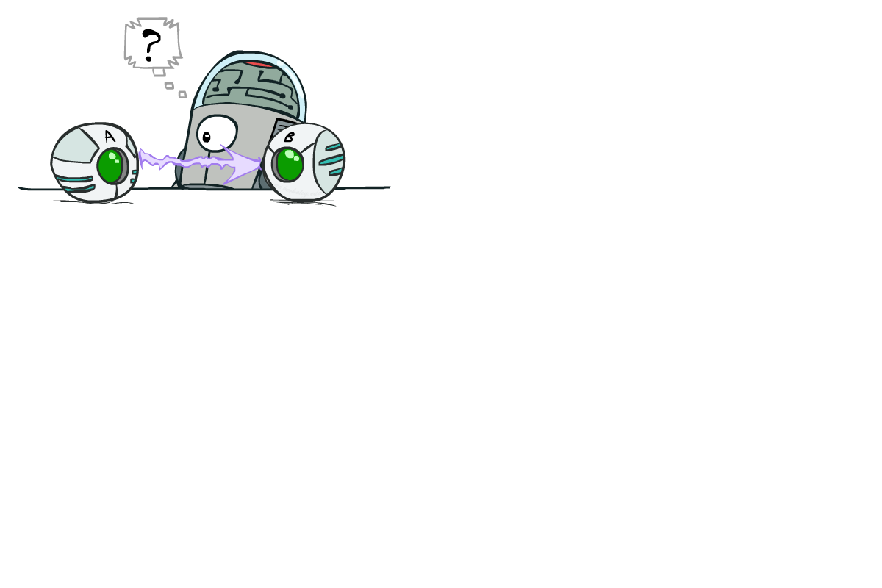
Causality?
When Bayes nets reflect the true causal patterns:
Often simpler (fewer parents, fewer parameters)
Often easier to assess probabilities
Often more robust: e.g., changes in frequency of burglaries should not affect the rest of the model!
BNs need not actually be causal
Sometimes no causal net exists over the domain (especially if variables are missing)
E.g. consider the variables Traffic and Umbrella
End up with arrows that reflect correlation, not causation
What do the arrows really mean?
Topology may happen to encode causal structure
Topology really encodes conditional independence: P(X_{i} | X₁,…,X_{i-1}) = P(X_{i} | Parents(X_{i}))

Slide 25
Conditional independence semantics
Every variable is conditionally independent of its non-descendants given its parents
Conditional independence semantics <=> global semantics

Slide 26
Example
V-structure
JohnCalls independent of Burglary given Alarm?
Yes
JohnCalls independent of MaryCalls given Alarm?
Yes
Burglary independent of Earthquake?
Yes
Burglary independent of Earthquake given Alarm?
NO!
Given that the alarm has sounded, both burglary and earthquake become more likely
But if we then learn that a burglary has happened, the alarm is explained away and the probability of earthquake drops back
Burglary
Earthquake
Alarm
John calls
Mary calls

Slide 27
Markov blanket
A variable’s Markov blanket consists of parents, children, children’s other parents
Every variable is conditionally independent of all other variables given its Markov blanket

Slide 28

Bayes Nets
So far: how a Bayes net encodes a joint distribution
Next: how to answer queries, i.e., compute conditional probabilities of queries given evidence

